Slide 1
Artificial Intelligence and Machine Learning for Every .NET Developer
Eng Teong Cheah
MVP in Developer Technologies
Twitter: @walkercet

Slide 2
What is Machine Learning?

Slide 3

Machine Learning “Programming the UnProgrammable”
{
{
Is this a face?
Price of Shirt?
f(x)
f(x)
“It has exquisite buttons … with long sleeves …works for casual as well as business settings”
Notes:
Basically, machine learning is a way to create function that was very difficult to do with traditional programming.

Slide 4



Machine Learning “Programming the UnProgrammable”
{
Machine Learning creates a
Face
Face
f(x) Model
Not a face
Not a face
Using this data
But it needs a lot of sample training data in order to predict properly… ;)
Notes:
So, for instance, you could create a function to identify objects, is this a face or not? If you were doing that in the traditional way, it would be very complex, like trying to identify if it has a mouth or eyes, etc. But instead of that, or another example would be you want to say what’s going to be the price of a shirt. So, in order to do that with AI you need to train a model. So, therefore, you provide a bunch of data about faces, so you say “This is a face, this is not a face.”. Then, based on that training, the model would work. Something important is that you need a lot of data to train machine learning models.

Slide 5
What problems can you solve with Machine Learning?

Slide 6
Many Machine Learning Tasks!
Supervised ML (Infers label)
Unsupervised ML (Infers structure)
Linear Discriminant Analysis
Clustering
Regression
Topic Modeling
( K-means
Mixture models
Hierarchical clustering)
Structured prediction
Naïve Bayes
Linear regression
Logistic regression
Dimensionality Reduction
Decision Trees
Anomaly detection
Binary Classification
Multi-class Classification
Latent variable models
Topic modeling
k-nearest neighbor
Neural Networks
(MultiLayer Perception, etc.)
Neural Networks
(Autoencoders,
Self-organizing maps, etc.)
Support Vector Machines
Notes:
So, what problems can you solve with machine learning? There are many problems.
Also, those problems are related to more technical ML tasks. This is another world for developers, like many things like regression, clustering, anomaly detection, and so on.

Slide 7
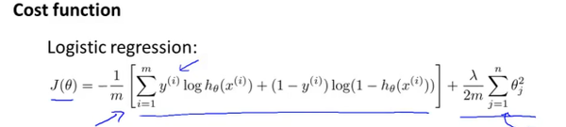
“Democratize Machine Learning and AI in general, for developers”
THE GOAL
Notes:
What we want to do with Microsoft Development technologies is to simplify these from a development perspective. Instead of having to learn the low level details about machine learning, even those formulas for logistic regression or whatever, we just want to democratize, so it is easy to se AI in general for developers.

Slide 8
What AI, Machine Learning and Deep Learning technologies can you use in .NET applications?

Slide 9
AI & ML portfolio for .NET applications
Consume pre-built/pre-trained models or build your own custom model?
AI, ML and DeepLearning technologies
Consume (Pre-built AI: Ready to use)
Build your own (Custom AI)
Azure
Cognitive Services
Pre-trained models
(ONNX, CoreML, WindowsML)
Azure Machine Learning
Studio
ML.NET
Integration
TensorFlow,
CNTK,
Torch,
ONNX, etc..
Easier / Less control
Harder / Full control
Client apps
Bots
(Bot Framework)
Web apps
(ASP.NET)
Mobile apps and IoT Edge devices
(Xamarin) (IoT Edge SDKS)
Visual Studio and .NET
Notes:
So, let’s first position the multiple technologies that we have for AI.
First of all, you could have technologies that you can consume like pre-built AI.
For that, you could use Azure Cognitive Services or other pre-trained models like ONNX, which is on its or CoreML or Windows ML in your program. So basically, you are takin up pre-trained model and you are just running it or predicting what we call the scoring and just to us it in your applications. So, you’re infusing machine learning to your current applications. But you can go further because you can also create your own AI, your own machine learning models. So for instance, we have multiple choices. You could use Azure Machine Learning Studio or you could use Machine Learning .net, ML.NET or you can also use other deep learning technologies like TensorFlow, CNTK or Torch.

Slide 10
Pre-built AI: Using Azure Cognitive Services in .NET applications

Slide 11







Microsoft Cognitive Services
Commoditized AI
Vision
From faces to feelings, allow your apps to understand images and video
Speech
Hear and speak to your users by filtering noise, identifying speakers, and understanding intent
Language
Process text and learn how to recognize what users want
Knowledge
Tap into rich knowledge amassed from the web, academia, or your own data
Search
Access billions of web pages, images, videos, and news with the power of Bing APIs
Labs
An early look at emerging Cognitive Services technologies: discover, try and give feedback on new technologies before general availability
Notes:
So, let us start with pre-built AI using Cognitive Services. Probably, you saw this slide, if you saw any presentation about Cognitive Services.

Slide 12
Microsoft Cognitive Services
Commoditized AI
Computer Vision
Content Moderator
Emotion
Face
Video Indexer
Custom Vision Service
Bing Speech
Speaker Recognition
Custom Speech Service
Bing Spell Check
Linguistic Analysis
Text Analytics
Translator Text & Speech
Web Language Model
Language Understanding
Academic Knowledge
Entity Linking
Knowledge Exploration
Recommendations
QnA Maker
Custom Decision Service
Bing Autosuggest
Bing Image Search
Bing News Search
Bing Video Search
Bing Web Search
Bing Entity Search
Bing Custom Search
Project Prague (gesture)
Project Cuzco (events)
Project Johannesburg (routing)
Project Nanjing (isochrones)
Project Abu Dhabi (distance matrix)
Project Wollongong (location)
Vision
Speech
Language
Knowledge
Search
Labs
Notes:
Basically, we are providing here a higher level services that you can just use and consume like Computer Vision or Speech Recognition or Language Understanding.

Slide 13
Custom Machine Learning: Using ML.NET

Slide 14
Is pre-trained/pre-built Machine Learning enough for you? i.e. Azure Cognitive Services, etc.
As always.. the answer is… :
“It depends…” ;)
Notes:
So, let’s move on to the next section. So now, let’s talk about cost of machine learning and specifically using ML.NET. So, the first question is okay. So you have pre-trained, pre-built machine learning, is that enough for me like Cognitive Services? Well, assume know the answer is it depends. It might fit your needs, but sometimes you need something else.

Slide 15





Pre-built ML Models (Azure Cognitive Services)
e.g. Sentiment Analysis using Azure Cognitive Services
TextAnalyticsAPI client = new TextAnalyticsAPI();
client.AzureRegion = AzureRegions.Westus;
client.SubscriptionKey = "1bf33391DeadFish"; client.Sentiment(
new MultiLanguageBatchInput(
new List<MultiLanguageInput>()
{
new MultiLanguageInput("en","0", "This is a great vacuum cleaner")
}));
Vision
Speech
Language
Labs
Knowledge
Search
96% positive
Consume (C#, VB, F#)
Easy / Less Control
Full Control / Harder
Notes:
So, for instance, if you use Cognitive Services sentiment analysis service and then you provide like these. This is a great vacuum cleaner then that’s a positive , right?

Slide 16
Pre-built ML Models (Azure Cognitive Services)
e.g. Sentiment Analysis using Azure Cognitive Services
TextAnalyticsAPI client = new TextAnalyticsAPI();
client.AzureRegion = AzureRegions.Westus;
client.SubscriptionKey = "1bf33391DeadFish"; client.Sentiment(
new MultiLanguageBatchInput(
new List<MultiLanguageInput>()
{
new MultiLanguageInput("en","0", "This vacuum cleaner sucks so much dirt")
}));
Vision
Speech
Language
Labs
Knowledge
Search
9% positive
Consume (C#, VB, F#)
Easy / Less Control
Full Control / Harder
Notes:
But, if you provide another sentence like these they can cleaner sucks so much dirt that will identified as not positive and you might want to train these in a different way, right? So, this is just one example.

Slide 17
Build your own (custom) ML Models
Prepare Your Data
Build, Train
& Evaluate
Run
Full Control / Harder
Easy / Less Control
Notes:
But there are many cases where you want to not just train with your data that you can do with Custom Vision, but also there are other services in Cognitive Services that you can do custom training and you might also use different algorithms. So for DOD in Custom Vison, you typically have different phases. You prepare your data, you need to work with the data, message your data a lot, and then you need to build and train your own model. So, this is the difference compared to pre-built AI, and then just run it or consume it, or use it in your application.

Slide 18





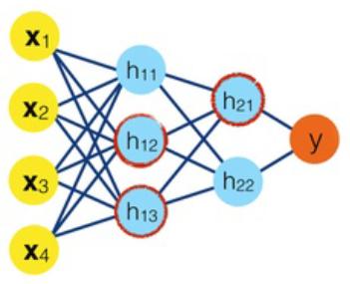



Processes for Building your own (custom) ML Models
Historic
Data
Web apps /
Services
Mobile apps
ML model
file
Run /
Predict
Build & Train
Machine Learning
lifecycle
Desktop apps
?
(Trained)
Bots
Test /
Evaluate
IoT
Prepare Data, Build and Train an ML model
Run/consume the ML model in app
Notes:
So , a little bit more detail in process is you have a bunch of historic data, then you will be building your model and training with that data and then you test it, you evaluate the accuracy of your models, and when you think it’s good, then you generate model file, which in the case of ML.NET is a zip file, and then you run it or predict or score in any application.

Slide 19




Introducing ML.NET
Currently in v0.5 preview Sept-2018
Machine Learning framework made for .NET developers
(Supported on Windows, Linux, and macOS)
Build your own
Developer Focused
Proven & Extensible
Open Source
&
Cross Platform
https://github.com/dotnet/machinelearning
Notes:
So, ML.NET is a framework first made for data developers, and it’s proven and extensible because we’ve been using these libraries internally in Microsoft for quite a few years. I know we are making it public and simplifying it with a new API.

Slide 20

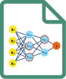


ML.NET is a framework for custom ML
Historic
Data
Business Application
(Web/Service/Desktop/Mobile)
.csv files
etc.
.NET Core
or
.NET Framework
ML model
.ZIP file
Live
User’s
Data
Build &Train
Machine Learning
lifecycle
ML.NET
.NET Core
or
.NET Framework
API to consume
the model
(Trained)
ML model
file
Test /
Evaluate
Run /
Predict
?
.NET Core
or
.NET Framework
Prepare Data, Build and Train an ML model
Predict: Run/consume the ML model
ML Tasks, Data Transforms, Learners/Algorithms
API to run the model
ML.NET Model Builder
(UI Desktop Tool)
ML.NET API
(.NET Console app, etc.)
nuget
ML.NET API
(.NET app)
nuget
Notes:
Basically, if we go back to the process that we previously saw. You can build and train your models on .NET Core or .NET Framework by simply adding the NuGet packages of .NET ML.NET in your application. In the future we will also provide a UI application model builder, so you can use it graphically as well and then that zip file with your model, then you can use it in your application, which also be .NET Core or .NET Framework and simply by adding the NuGet package of ML.NET and loading that zip file and then scoring or predicting. So, that’s the high level process vision.

Slide 21
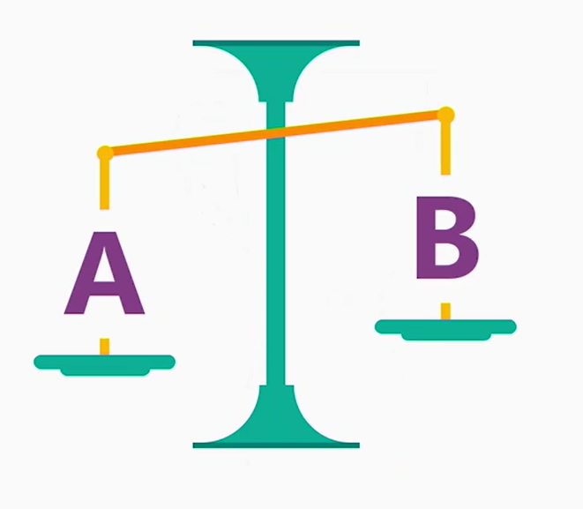
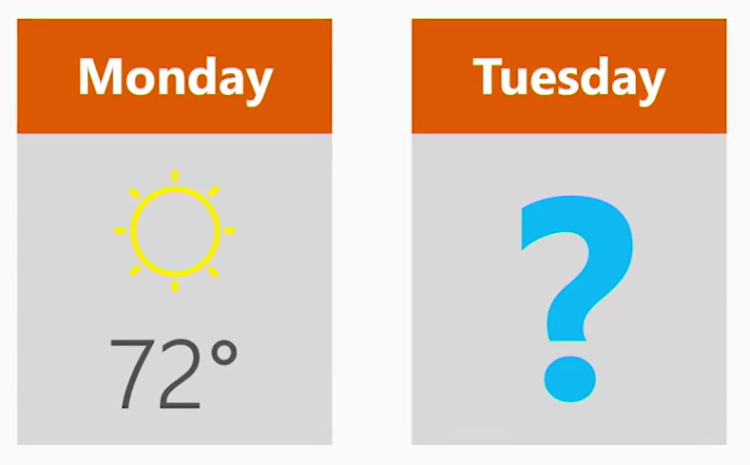
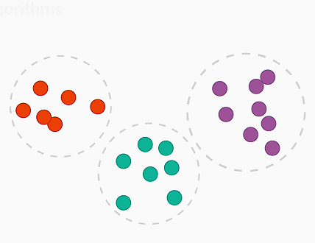
A few problems you can solve with ML.NET
Is this A or B?
How much? How many?
How is this organized?
Notes:
Then, what can you do with ML.NET? Usually ML.NET focuses most of all on the traditional machine learning problems with data, which is very useful for the enterprise, for instance. So you can identify some data is a or b, which is binary classification, or you can predict how much about something like forecasting, or clustering and so on.

Slide 22
Mapping from Problems to ML Tasks
Problems
ML Tasks
Predict value (price, forecast, etc.)
Time Series
Something is A or B
Clustering
Detect issues/problems
Recommendations
Group similar objects into sets
Multi-class Classification
Predict relevance of objects
Regression
Predict values based on time/seasons historic data
Binary Classification
Advice on products/movies/etc.
Ranking
Classify things across multiple categories
Anomaly Detection
Notes:
So there are many problems that we can solve with machine learning like predictive value. It would be regression or something is A or B, binary classification or detect issues or problems that might happen in some, for instance, in devices coming a bunch of events, then you might detect anomaly detection, and so on. So, we want to simplify this. So, we’re showing you problems instead of ML tasks in all the documentation on samples, and so we make it simpler to use.

Slide 23
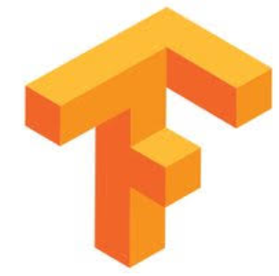

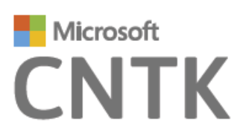

ML.NET is a framework first
Developer-friendly ML APIs to:
.NET Standard
.NET Core
.NET Framework
nuget
Build & Train ML.NET models
Run any model
Preliminary support of TensorFlow scoring in ML.NET is available since v0.5
Transforms
Learners
Misc.
Future Extensions
Text
Linear
ML Data framework
Schema
Boosted Trees
Evaluators
Missing values
Svm
Calibrators
TensorFlow
Categorical
K-Means
Data loaders
Normalization
Feature Selection
Notes:
So, something we really want to highlight is that ML.NET is a framework first. So, it’s basically libraries, NuGet packages, but we will also provide tooling for it, and these for custom machine learning. So you can build and train, or you can then run any model. It supports .NET Core or .NET Framework. Then here are the elements that you use with this API. You use transforms to make transformations, to concatenate data within dataset that you’re going to be using for the training, or convert to numeric vectors, featurize, and so on. We have learners or algorithms that once you want to use depending on the problem. Finally, we are also integrating or extending ML.NET with deep learning frameworks like in this case, Tensorflow.

Slide 24

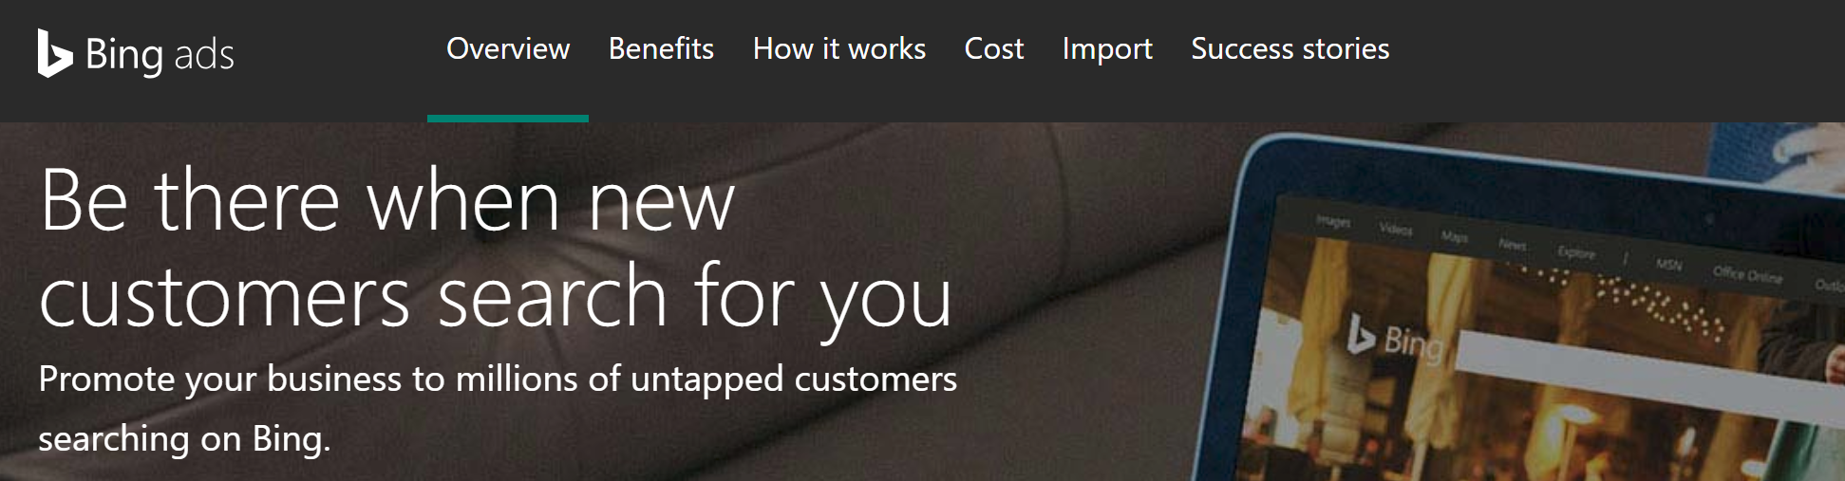

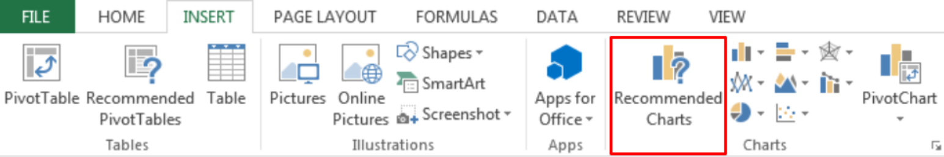

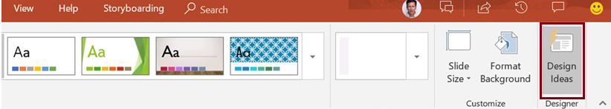

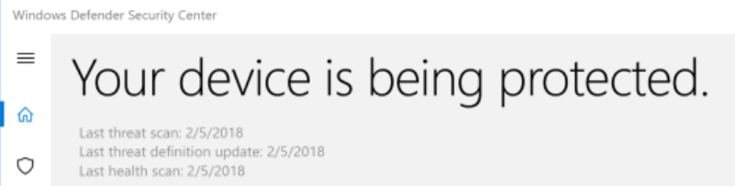
ML.NET: Proven at large scale in Microsoft
Bing Ads
Excel
Power Point
Windows 10
+ more!
Notes:
I want to really highlight that this is not something just new even when it is in preview. We’ve been using internally ML.NET in Microsoft in products like Bing or Excel or PowerPoint or Windows 10.

Slide 25
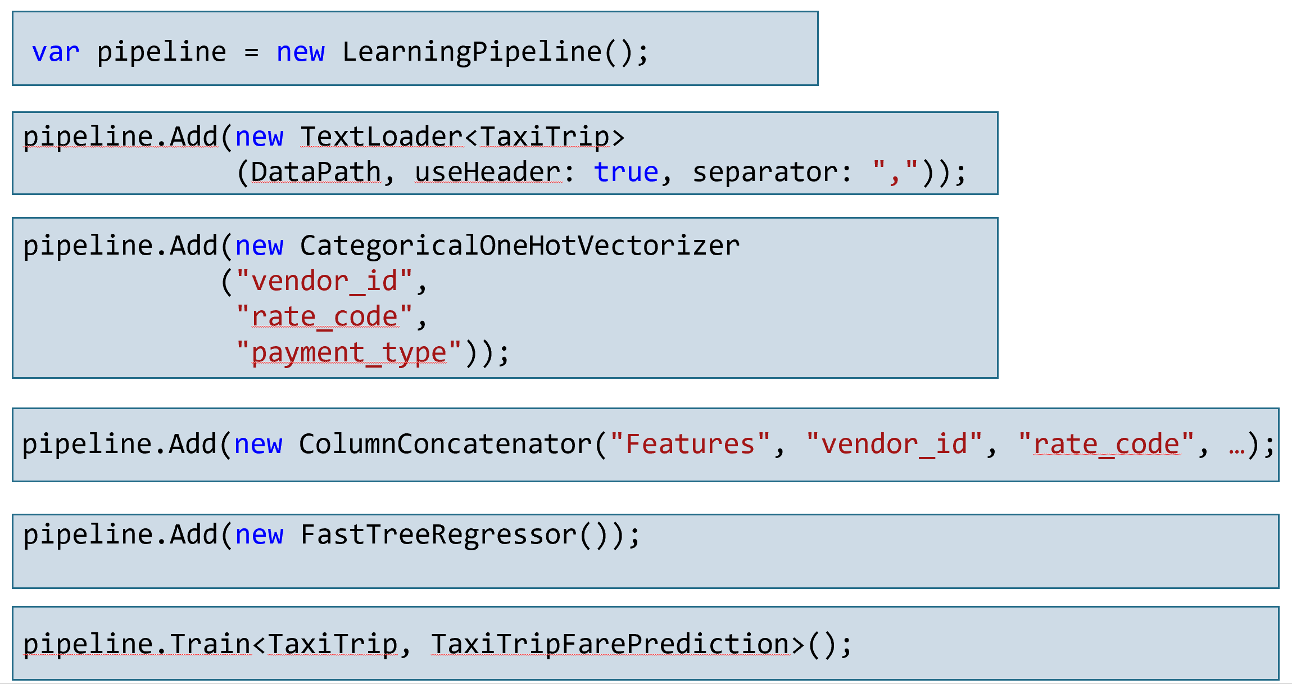

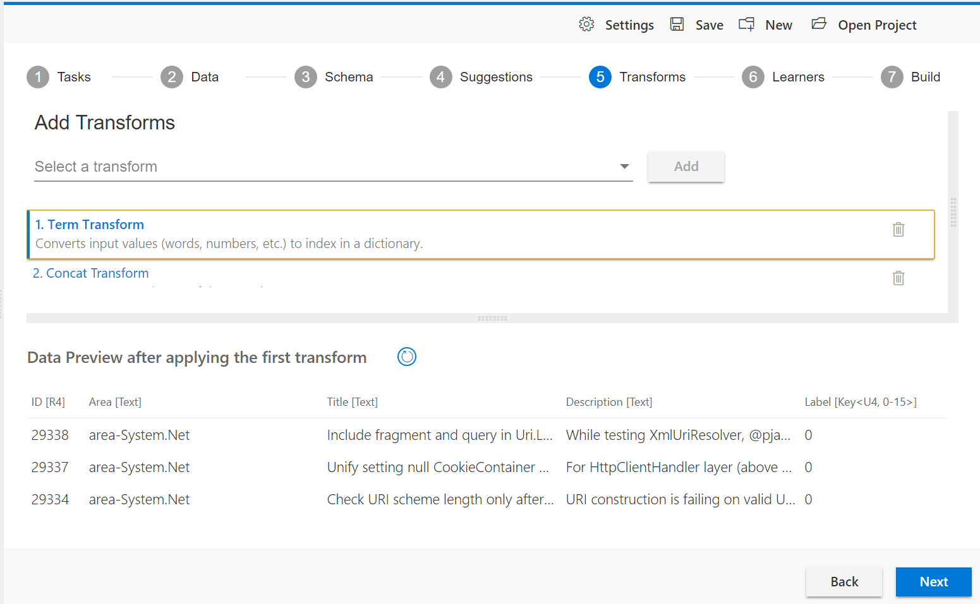
Democratize Machine Learning custom models for .NET developers with a framework and tools especially tailored for developers
The Goal for ML.NET ?
.NET code-first approach to build & train custom models
UI tool,
easy to get started for .NET developers
(*) To be released
Notes:
Just a final highlight about ML.NET is that it’s also we want to democratize custom AI or custom machine learning for .NET developers. So, the difference is that we are targeting .NET developers with ML.NET either for training models, and also we would provide in this democratization based on code APIs, but also on a UI tool that we’ll be releasing soon.

Slide 26


Enterprise innovation goes across all technologies, not just AI…
State-of-the-art applications
Just ML.NET Hello-World samples? Or…
Comprehensive list of samples
End-to-end reference applications
Cloud-Native applications + AI/ML
Cloud-Native: Microservices
Cloud
Containers
CI/CD
AI/ML Bots
The enterprise
Notes:
Then finally, I also want to highlight third useful in your Enterprise, the Enterprise might be researching not just AI/ML, but also maybe microservices and bots, and so on. So, that’s why we are also releasing this sample or this reference application that I was showing.

Slide 27
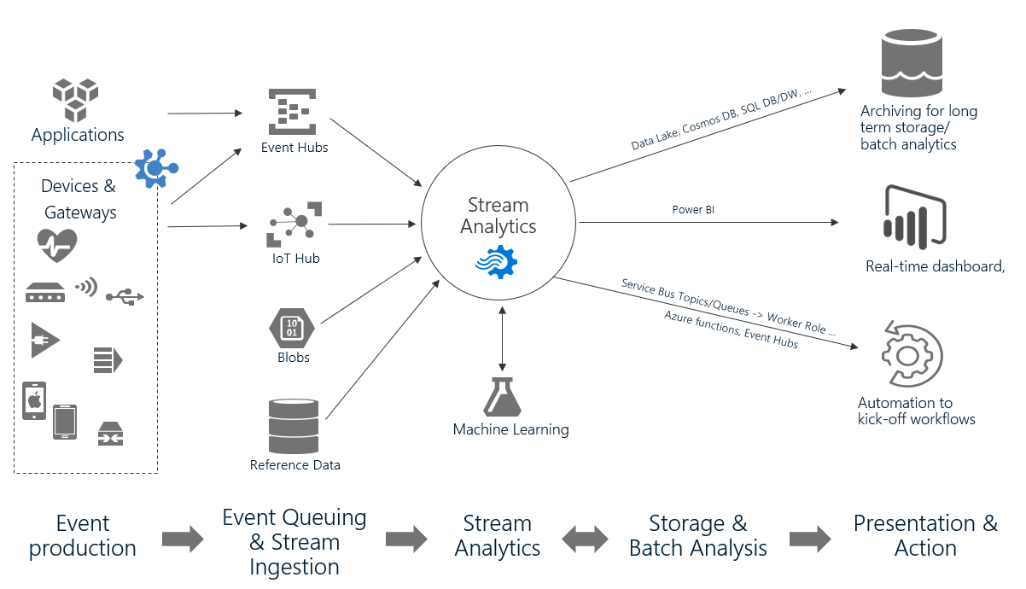
Azure Stream Analytics
Generally Available
Fully managed PaaS service for real-time analytics and complex event processing with built-in integration with over dozen services in Azure
Author powerful queries with simple SQL like language
Available in the cloud and on Azure IoT Edge runtime
Key solution scenarios:
Remote monitoring
Predictive maintenance
Real-time dashboarding
Fleet monitoring and connected cars
IT infrastructure and network monitoring
Monitor online gaming
Notes:
Something else that I want to highlight is about Azure Stream Analytics. So this is right now generally available and you can integrate machine learning and also with ML.NET with Stream Analytics. So Stream Analytics is made, so you can gather millions of events from devices and then through IoT hub. Then, in real time, you could also create queries and those queries could also talking to your models and depending on what you are predicting, you could do different things. That’s one way of using Stream Analytics integrated to Machine Learning. A very typical thing would be for predictive maintenance. Then, in real time, you could be predicting what’s going on the devices, if there’s an issue. Then, the other possibility,

Slide 28
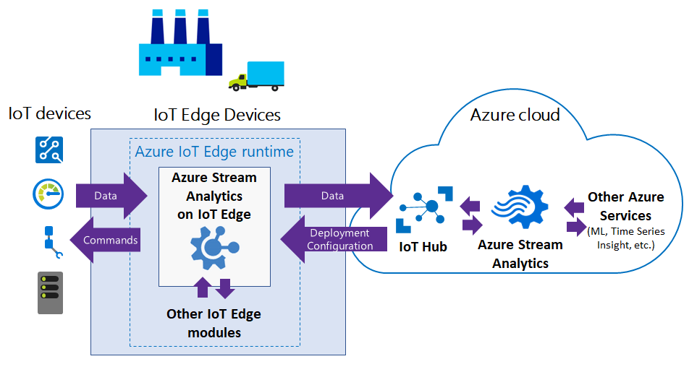
.NET extensibility in ASA on IoT Edge
Request access to Preview
Private Preview
https://aka.ms/ASApreview1
Extend existing query language with C# UDF (User defined functions) to enable new possibilities:
Complex math functions
Machine learning on Edge w/ ML.NET
String/Date manipulations
Data imputation
Custom De-serializers can support any data formats including:
Protobuf
Parquet
XML etc,
ASA module
C# function with
ML.NET model
for scoring
Notes:
And this is new, this is in private preview right now, but you can request access in that URL above. You can also use Azure Stream Analytics within an IoT device, run it on the Edge, and gather the vents from the devices. Let’s say, you have Raspberry Pi doing that or any other IoT Edge device, and you run Azure Stream Analytics internally in that device. You can also, and this is new, you could also because this is C-Sharp as well, you could create a module in C-Sharp, which is a C-Sharp function and then use ML.NET for scoring models. So any model that you created, you train outside, then you could reuse it within the IoT Edge device, and then on the fly, you could be predicting if there’s an issue or whatever the problem you’re solving or you’re predicting, and then finally, communicating with the Cloud.

Slide 29
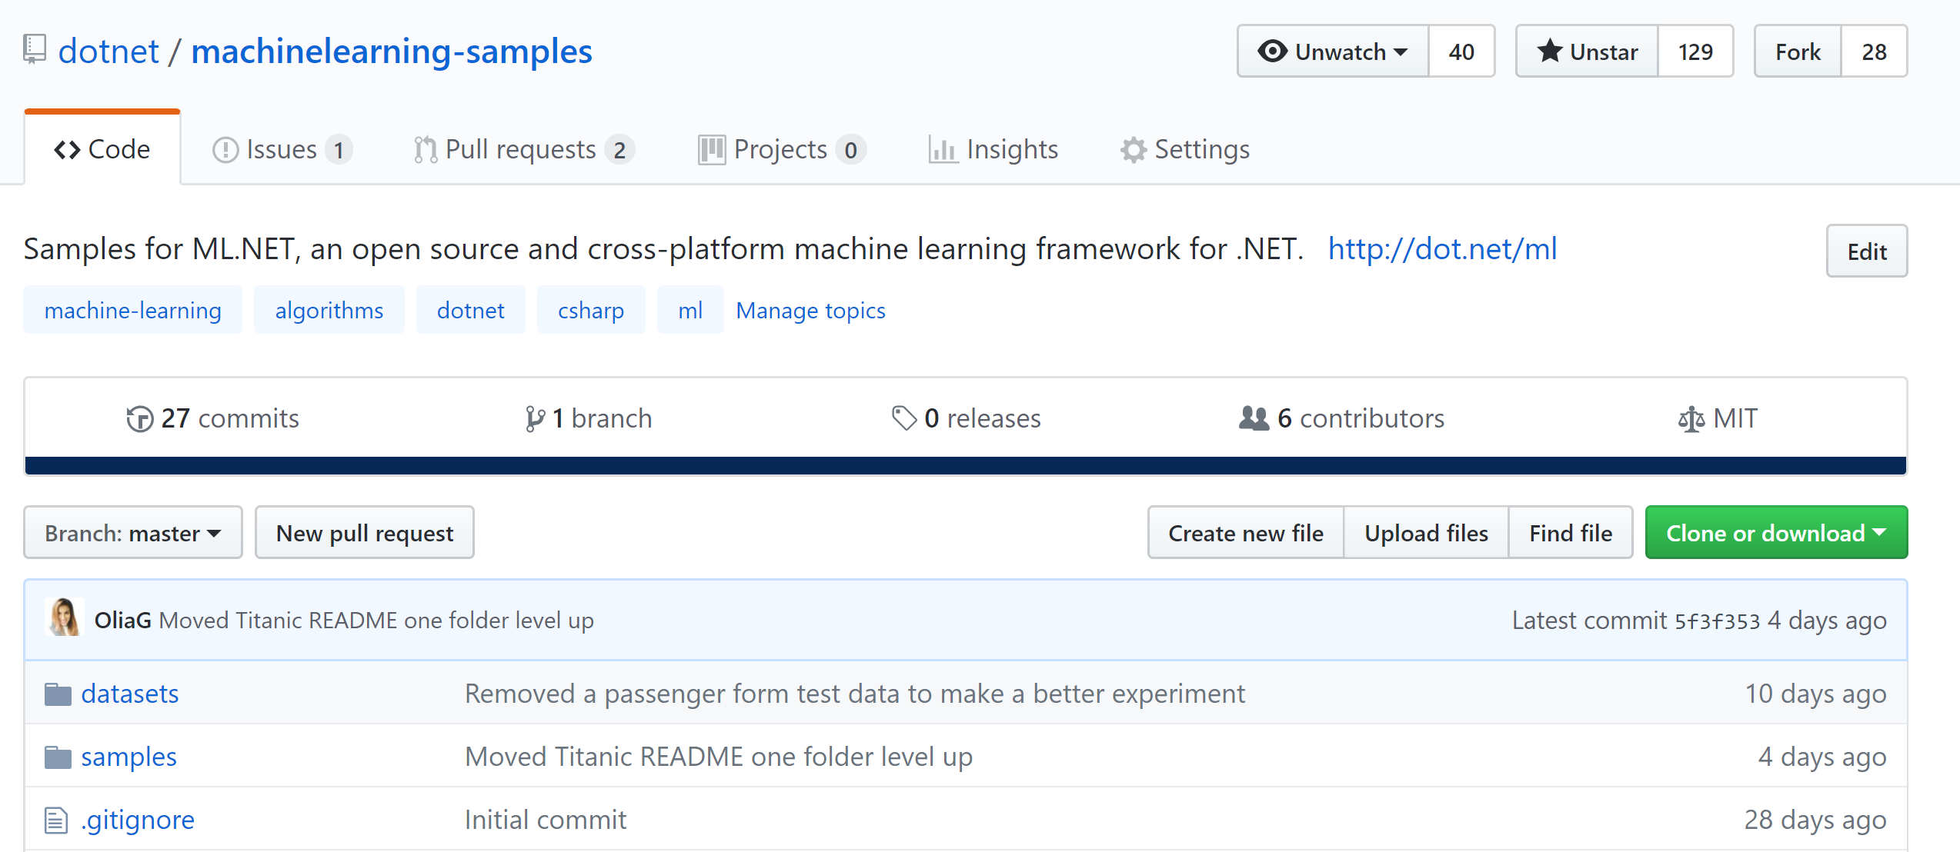
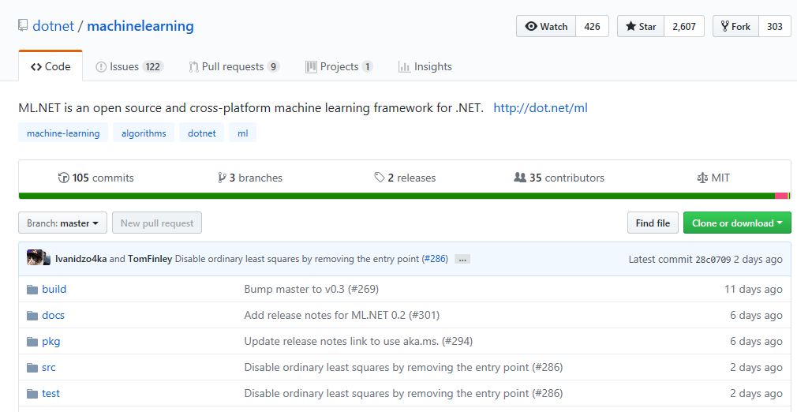
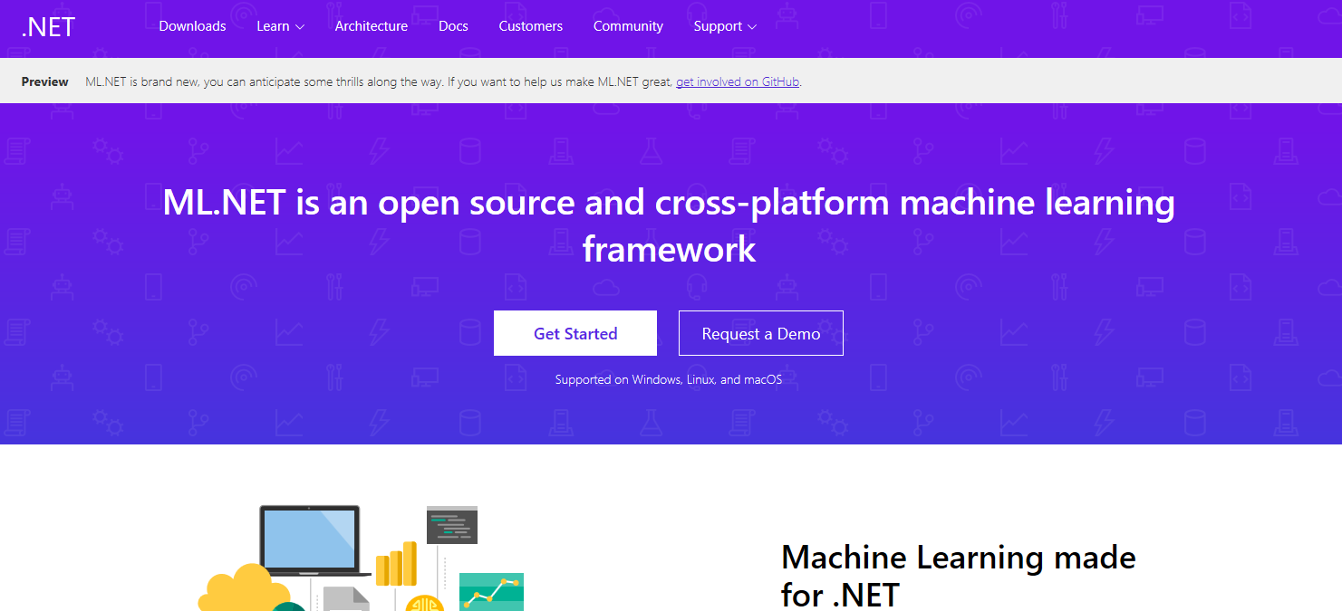
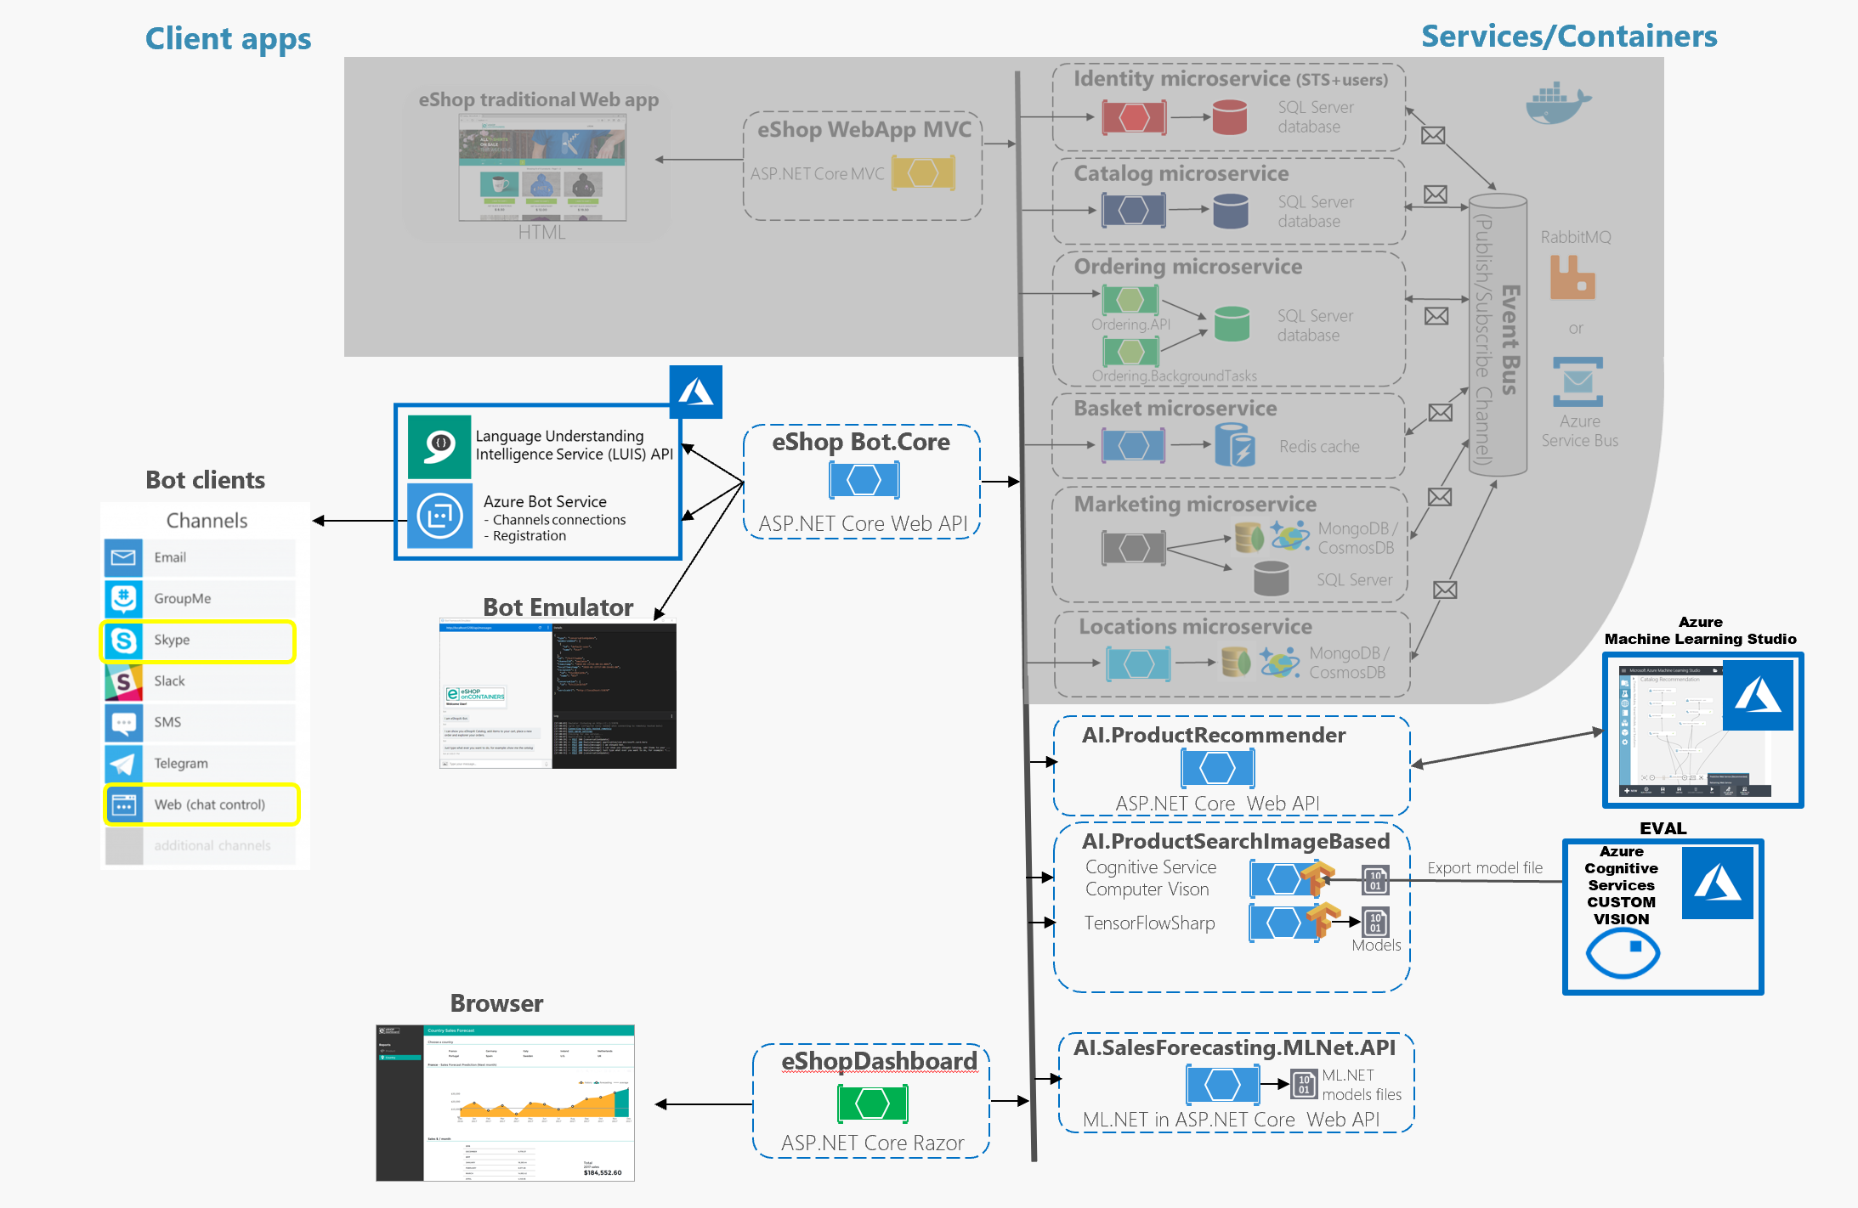
Resources
Get Started dot.net/ml
ML.NET Samples
(eShopDashboard, etc.) http://github.com/dotnet/machinelearning-samples
Get Involved in OSS http://github.com/dotnet/machinelearning/
http://aka.ms/newapifeedback/
End-to-end Native App eShopOnContainersAI:
https://github.com/dotnet-architecture/eShopOnContainersAI
Notes:
That’s almost all that I wanted to cover. So you have more resources in the .NET Machine Learning page. Also, if you want to see a simple “Hello World” very easy to get started samples, go to github/donet/machinelearnig-samples. You can also go to the ML .NET page if you want a see the internals about ML.NET and collaborate with the open source project.

Slide 30
Thank you.

